Slide 1
METROPLUS HEALTH PLAN
PROVIDER TRAINING GUIDE FOR VFCA

Slide 2
ORIENTATION TOPICS
MetroPlus Overview 3
MetroPlus Product Lines 4
Member Eligibility Verification 5
Overview: Foster Care Transition to MMC 6
VFCA Core Principles 7
Foster Care Providers 8
Authorization/Notification Requirements 9-10
MetroPlus Website & Provider Portal 11
MHP Vendor Information 12
What is Article 29-I 13
Core Limited Health Related SVCS Per Diem 14
Optional Article 29-I Services 15
Population Served by Article 29-I 16
Services Do Not Include 17
Fundamental Requirements 18
Who Receive these Services? 19-20
Notification of Foster Care Placement 21
Contacting the Foster Care Liaison 22
Claim Submission 23
Paper Claim Submission (UB04) 24-25
Guidance on Claim Submission 26-27
Contact Information 28

Slide 3
METROPLUS OVERVIEW
MetroPlus is a Prepaid Health Services Plan (PHSP) licensed to operate in:
Manhattan
Brooklyn
Queens
Bronx
Staten Island (Currently for Medicaid, Child Health Plus, HARP, Marketplace, and Essential Plan only)
MetroPlus, which began operations in 1985, is a wholly owned subsidiary of NYC Health + Hospitals.

Slide 4
METROPLUS PRODUCT LINES
Medicaid Managed Care (MMC)
Child Health Plus (CHP)
Qualified Health Plan (MarketPlace Plans)
Partnership in Care (SNP)
Essential Plan (EP)
MetroPlus Medicare Advantage Plan (HMO SNP)
MetroPlus Medicare Platinum Plan (HMO)
UltraCare (Medicaid Advantage Care (MAP))
MetroPlus Gold
MetroPlus Managed Long Term Care (MLTC)
MetroPlus Enhanced

Slide 5
MEMBER ELIGIBILITY VERIFICATION
Members’ coverage and PCP must be verified before every encounter.
Step 1: Ask to see their MetroPlus Member ID Card and a Photo ID
Step 2: Check member’s eligibility using one of these methods:
  MetroPlus Provider Portal:
http://providers.metroplus.org
• EMEVS web site: www.emedny.org for Medicaid, Medicaid HIV SNP and MetroPlus
Medicaid Advantage.
• EMEVS verification line:
  • Call 800-997-1111
• Enter the MetroPlus Provider Number 01529762 and the Plan Code 092
• MetroPlus Customer Services: 800-303-9626

Slide 6
OVERVIEW: FOSTER CARE TRANSITION TO MMC
Part of the Medicaid Redesign Children’s System Transformation
Voluntary Foster Care Agencies (VFCA) will be licensed under NYS Public Health Law Article 29-I to provide health related services
29-I Health Facility services will be included in MMC Plan benefit package effective July 1, 2021
Children in the care of VFCAs will be enrolled in managed care beginning July 1, 2021

Slide 7
VFCA CORE PRINCIPLES UNDER CHILDREN’S MEDICAID REDESIGN AND TRANSITION TO MANAGE CARE
Enhancing capacity to care for children placed with VFCAs and higher risk populations through both care management and coordination of mandated services
    Services may be provided by a variety of staff who meet state licensing requirements in accordance with applicable state law
    No loss of access to Medicaid services for children in foster care and families
Article 29-I Licensure and standardized guidelines to deliver services under managed care framework
MetroPlus will pay the Per diem rate for “Core Limited Health-Related Services” (defined by regulation)
MCO/VFCA collaboration to support transition to new models/expectations

Slide 8
FOSTER CARE PROVIDERS
Agencies designated for “Foster Care” ONLY can only provide CFTSS services to children who are in or discharged from foster care who meet medical necessity criteria, regardless of their diagnoses.
Children in or discharged from foster care are not restricted to the foster care only agency sites. Children discharged from foster care can continue to be served by a foster care only agency to support continuity of care.

Slide 9
AUTHORIZATION/NOTIFICATION REQUIREMENTS
You must call MetroPlus Customer Services at 800-303-9626 to obtain prior authorization and/or verification of benefits for the following services:
  Services provided by a Non-Participating Provider
  Behavioral Health and Substance Abuse Services (Benefits managed by Beacon Health Options)
    Authorization required for inpatient services
    Authorization for outpatient (See Beacon Provider Manual for details)
  Inpatient Admissions, Home Health Care, Skilled Nursing Facility Care, Durable Medical Equipment, Personal Care, Erectile Dysfunction Treatments, Potentially Cosmetic Procedures
  Physical Therapy, Occupational Therapy and Speech Therapy
    MetroPlus members enrolled in Medicare Advantage, Child Health Plus, MetroPlus Gold and “exempt” Medicaid members who are children 0 – 20 years of age and/or members with developmental disabilities will not be subject to the mandated benefit limit of twenty (20) visits per specialty type per calendar year but will still require authorization for services after visit number twenty.
    For all other non-exempt Medicaid members, there is a benefit limit of 20 visits per specialty type per calendar year. There is no means or opportunity to request an approval or an authorization that will allow for additional visits to be approved.

Slide 10
AUTHORIZATION/NOTIFICATION REQUIREMENTS
MetroPlus Health Plan does not require authorization or notification for any of the six Children and Family Treatment Support Services (CFTSS)
For Medical Authorization please refer to our authorization grid on our website https://www.metroplus.org/provider/tools
No utilization management will be conducted for:
  CLHRS provided by a 29-I Health Facility with which an enrollee is placed; or
  On any required assessment for a child/youth in foster care; mandated by OCFS or the LDSS; or ordered by a court.
For children in foster care transitioning to managed care on 7/1/2021, MHP will facilitate continued access to requested services without interruption and without conducting utilization review for LTSS, HCBS, or OLHRS at least 180 days from the effective date of enrollment.

Slide 11
METROPLUS WEBSITE & PROVIDER PORTAL
To register and access information 24/7 VISIT www.metroplus.org
Provider Manual, Provider Newsletters
Benefits
Provider Search, Provider Directory (PDF)
MetroPlus Provider Portal is a secure, HIPPA-compliant website that enables participating network providers to conduct online claims and authorization transactions accurately and efficiently, while providing them the opportunity to spend more time with who matters most-their patients.
Once you register, you can access the Provider Portal to:
Verify member eligibility, coverages, and benefit documents
Submit batch claims, re-credentialing applications ,provider updates, and access Provider Orientation
View and submit authorization and referral requests
Print forms and authorization letters
MetroPlus Provider Portal home page
http://providers.metroplus.org

Slide 12
METROPLUS HEALTH PLAN VENDOR INFORMATION
Beacon Health Options is contracted with MetroPlus Health Plan to provide Behavioral Health and Substance Abuse Benefit Management Services. Contact Beacon for authorization at 1-855-371-9228.
Integra Partners is contracted with MetroPlus Health Plan to provide Durable Medical Equipment (DME) benefit management services. Contact Integra Partners for prior authorizations at 1-866-679-1647 or via fax at 1-212-908-5185.
HealthPlex is contracted with MetroPlus Health Plan to provide Dental Benefit Management services, including utilization management for dental. Contact HealthPlex at 1-888-468-2183.

Slide 13
REVIEW OF THE BASICS: WHAT IS ARTICLE 29-I?
Article 29-I licensure authorizes VFCAs to provide the following:
Core Limited Health-Related Services (CLHRS)
  Nursing, Skill Building, and Medicaid Treatment Planning and Discharge Planning, Clinical Consultation and Supervision, Managed Care Liaison/Administrator
Other Limited Health-Related Services (OLHRS)
  Medicaid State Plan services (CFTSS)
  Medicaid Home and Community Based Services (HCBS) for Children
  Other Health-Related Services (such as psychiatric, psychological, etc.)
Voluntary Foster Care Agencies (VFCAs) must be licensed for the provision of Core and Other Limited Health-Related services and bill Medicaid Managed Care Plans to comply with the Corporate Practice of Medicine Standards

Slide 14
CORE LIMITED HEALTH RELATED SERVICES PER DIEM RATE REIMBURSEMET LEVELS
LEVEL | DESCRIPTION | FACILITY TYPE
LEVEL 1 | GENERAL TREATMENT | FOSTER BOARDING HOME
LEVEL 2 | SPECIALIZED TREATMENT | THERAPEUTIC BOARDING HOME (TBH)/AIDS MEDICALLY FRAGILE (FORMALLY BORDER BABIES) SPECIAL NEEDS
LEVEL 3 | CONGREGATE CARE | MATERNITY GROUP HOME (GH) AGENCY OPERATED BOARDING HOME (ABH) SUPERVISED INDEPENDENT LIVING PROGRAM (SILP)
LEVEL 4 | SPECIALIZED CONGREGATED CARE | GROUP RESIDENCE (GR) DIAGNOSTIC INSTITUTIONAL HARD TO PLACE/OTHER CONGREGATE RAISE THE AGE

Slide 15
OPTIONAL Article 29-I SERVICES
Referred to as Other Limited Health Related Services (OLHRS) and reimbursed according to a 29-I OLHRS Fee Schedule
Physical and Behavioral Health screening, diagnosis and treatment services, including but not limited to:
  On-going treatment of chronic conditions as specified in treatment plans
  Diagnosis and treatment related to episodic care for minor ailments, illness or injuries, including sick visits
  Psychiatric consultation, assessment and treatment
  Psychotropic medication treatment
  Developmental screening, testing and treatment
  Psychological screening, testing and treatment
  Smoking cessation treatment
  Alcohol and/or drug screening and intervention
  Laboratory Services
  Children and Family Treatment and Support Services
  Children’s Home and Community Based Services

Slide 16
POPULATIONS SERVED BY ARTICLE 29-I FACILITIES
Children/youth placed in foster care;
Babies residing with their parent who are placed in a 29-I Health Facility and in foster care (8D Babies);
Children/youth placed in a 29-I Health Facility by Committee on Special Education (CSE);
Pre-dispositional placed youth; and
Children/youth and adults who are discharged from a 29-I Health Facility (with limitations, as defined by the VFCA Policy Manual)

Slide 17
ARTICLE 29-I SERVICES DO NOT INCLUDE
Surgical services
Dental services
Orthodontic care
General hospital services including emergency care
Birth center services
Emergency intervention for major trauma
Treatment of life-threatening or potentially disabling conditions
Non-Routine Transportation

Slide 18
FUNDAMENTAL REQUIREMENTS FOR 29-I HEALTH FACILITY SERVICES
Voluntary Foster Care Agencies (VFCAs) must obtain and maintain an Article 29-I Health Facility license from the Department of Health to provide Health Related Services
The child’s/youth’s health/behavioral health record, treatment plan, service plan and/or plan of care must reflect that the services provided were medically necessary and appropriate and were rendered by qualified practitioners within their scope of practice (including supervision requirements), as defined in applicable State Law
29-I Health Facilities who wish to provide CFTSS and HCBS are required to receive the appropriate designation(s) from the State.
29-I Health Facilities providing laboratory services must have a valid Clinical Laboratory Improvement Amendments (CLIA) certification and only provide laboratory services outlined in their CLIA certification.

Slide 19
WHO CAN RECEIVE THESE SERVICES?
Any Medicaid eligible child who is currently placed with a VFCA can receive Core Limited Health-Related Services, Other Limited Health-Related Services, CFTSS, and HCBS from that VFCA if:
  The VFCA has an Article 29-I license to provide Core Limited Health-Related Services, and;
  It is designated to provide CFTSS or HCBS services, and;
  The child is Medicaid eligible AND the child meets medical necessity for CFTSS or meets HCBS criteria and;
  Contracted and credentialed with Managed Care to deliver Core Limited Health-Related Services and Other Limited Health-Related Services for children in MCOs.
  Notification of placement via Transmittal Form or other approved method is provided to MetroPlus Children’s Special Services department.
    Additional details and contact information is on slide 22

Slide 20
WHO CAN RECEIVE THESE SERVICES (CONTINUED)?
Any child who is currently not placed with your VFCA can receive Other Limited Health-Related Services, inclusive of CFTSS and HCBS, from your VFCA under the following circumstances:
  Post final discharge from foster care: CFTSS and/or HCBS can be provided
  to support continuity of care with no timeline for children/you up to age 21.
  Post final discharge from foster care: Other-Limited Health-Related Services
  specific to physician, psychiatrist, psychologist etc. can be provided for one
  year.
  A VFCA provider can provide CFTSS and Other Limited Health-Related
  Services to any child placed in another VFCA that is not already providing these
  services at the time or children in the direct placement of a Local Department of
  Social Services.

Slide 21
NOTIFICATION OF FOSTER CARE PLACEMENT
VFCAs must notify managed care using the Transmittal Form about children placed in foster when:
  They are newly placed in foster care,
  Their level of placement has changed (to a different level or to a different address within the same level),
  They are discharged from foster care.
The Foster Care Liaison is the dedicated staff person in the Children’s Special Services (CSS) department who will receive this notification, coordinate the issuance of an updated MetroPlus eligibility letter and card to the VFCA, and assist with coordinating care.
Transmittal Forms may be submitted via:
  CSS Email: childrensspecialservice@metroplus.org
  CSS Fax: 212-908-3018
  Provider Portal

Slide 22
Contacting the Foster Care Liaison (FCL)
The Children’s Special Services Department has assigned a contact and created a direct line for VFCAs, ACS, and LDSS to communicate with MHP:
  MetroPlus Foster Care Liaison: Olanike (Nikki) Oyeyemi
  Direct line: 212-908-4000
  Cell phone: 646-599-5965
  oyeyeo@metroplus.org
Contact the MHP Foster Care Liaison to:
  Coordinate care for members
  Refer members to care management
  Collaborate on discharge planning from an inpatient admission
  Collaborate on discharge planning from foster care

Slide 23
CLAIM SUBMISSION
Claims must be submitted detailing all services rendered for all capitated and fee-for-service encounters within 90 days of the date of service or discharge. Please allow 30 days from claim submission date to receive payment for Medicare claims, 45 days for all other claims.
  Claims for all members can be submitted electronically using Emdeon Payer ID# 13265.
  Paper claims must be submitted on HCFA 1500 or UB-04 forms.
  A guide for completing a UB-04 can be found at
  https://www.metroplus.org/provider/tools
  29-I billing guidance can be located at https://www.metroplus.org/provider/tools
  Send paper claims for Medicaid, Child Health Plus, Essential Plan and MetroPlus Gold to:
    MetroPlus Health Plan
    P.O. Box 830480
    Birmingham, AL 35283-0480

Slide 24
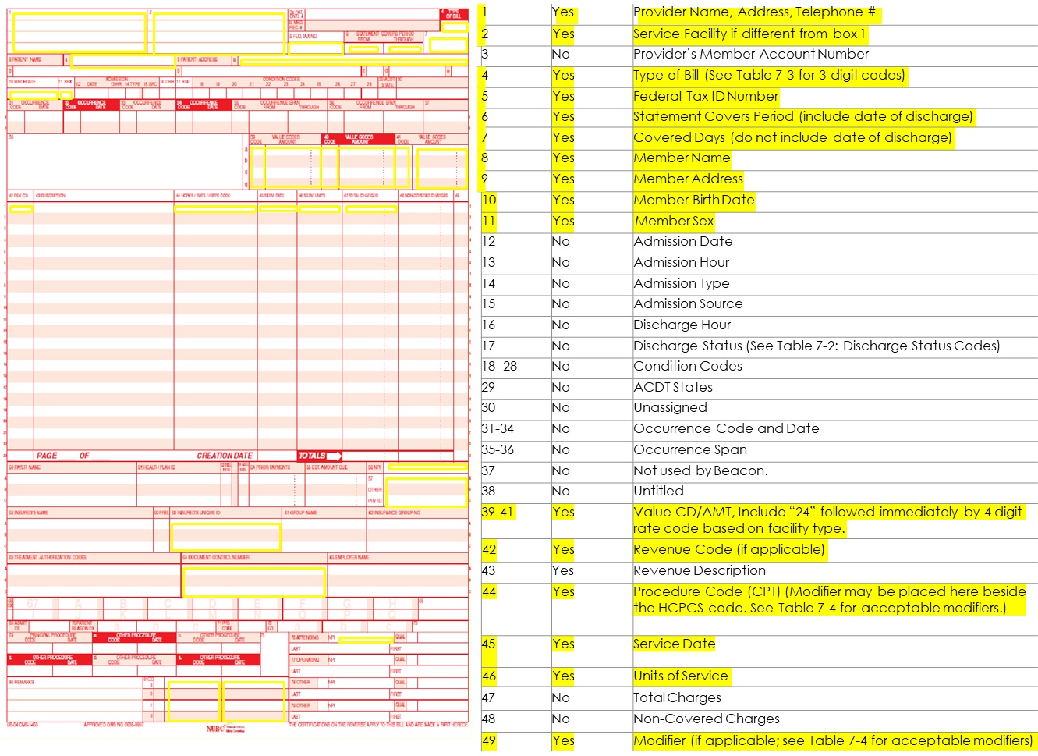
PAPER CLAIM SUBMISSION (UB04)
Highlighted are the required fields. In addition, diagnosis code is also a required field.

Slide 25
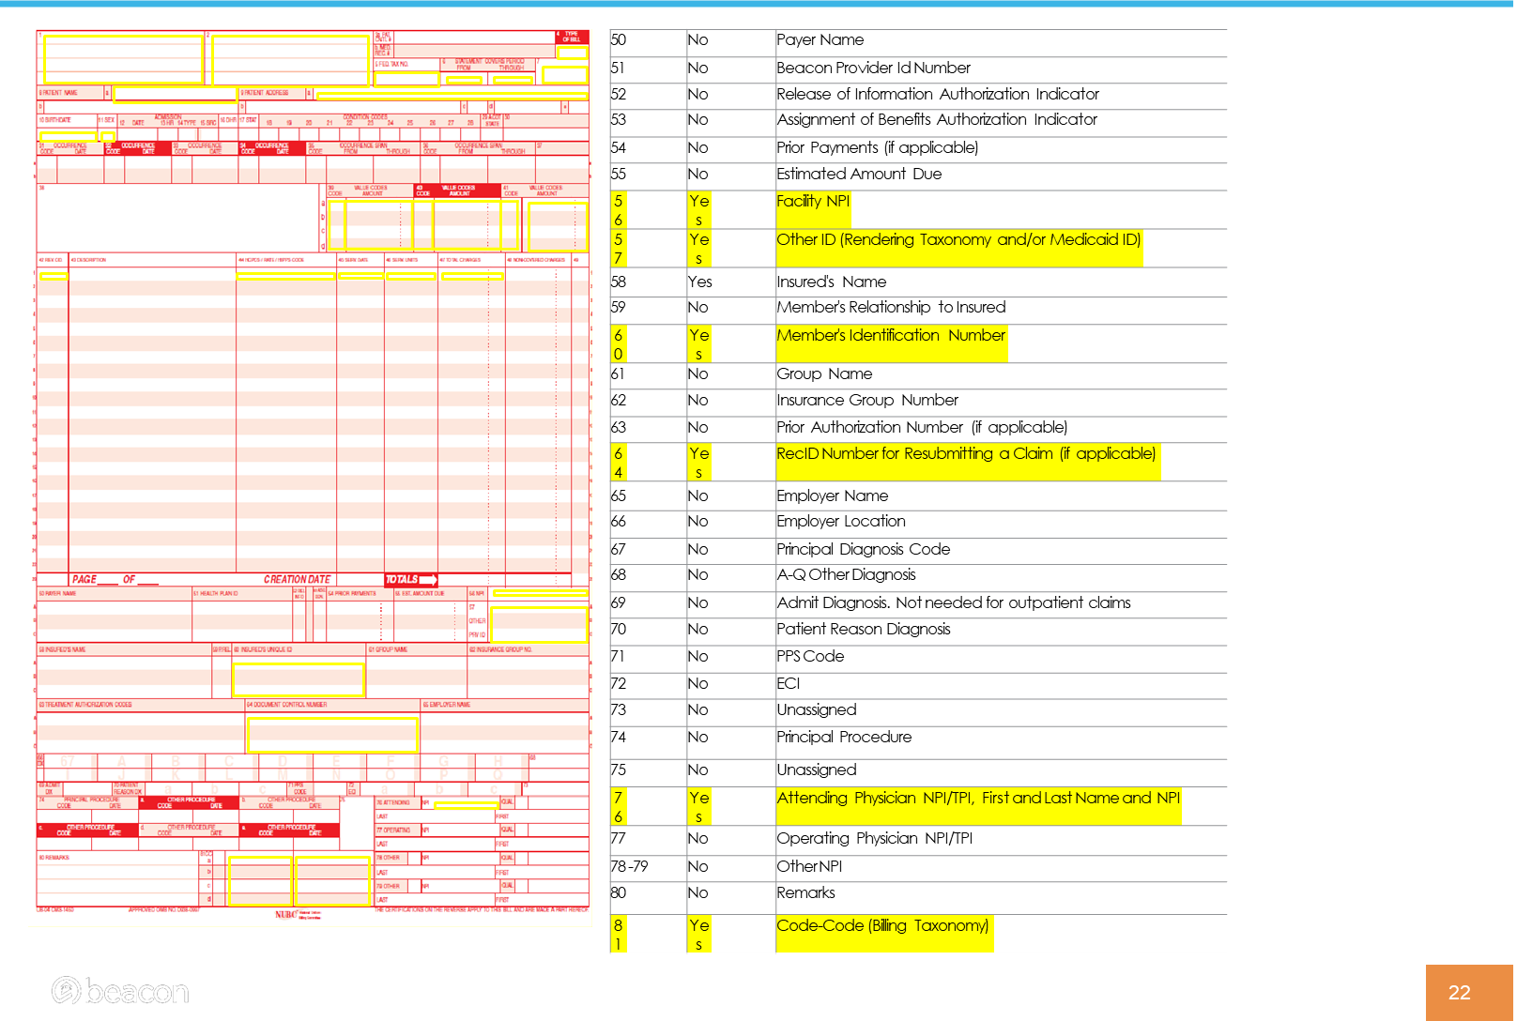
PAPER CLAIM SUBMISSION (UB04)
Highlighted are the required fields. . In addition, diagnosis code is also a required field.

Slide 26
GUIDANCE ON CLAIMS SUBMISSION
Bill MHP following guidance posted by the state in the Children’s Health and Behavioral Health Billing and Coding Manual. A valid diagnosis code is required.
Make sure to use a valid combination of procedure codes, modifiers and rate codes. Claims should be submitted following State guidance as outlined in the State Taxonomy Grid.
MHP offers claims testing for new providers. We encourage providers to take advantage of this. For more details, please contact our Provider Relations Department at networkrelations@metroplus.org

Slide 27
GUIDANCE ON CLAIMS SUBMISSION
Verify if services are covered by MHP or carved out to Medicaid Fee for Service.
Make sure a member is eligible for the services on the date's services are rendered.
Ensure to submit claims within the timely filing limit.
Submit “primary” and “add-on” codes on the same claim form.
Use UB04- Inpatient Institutional form.

Slide 28
CONTACT INFORMATION
DEPARTMENT | Contact Information
Customer Service | MetroPlus Customer Services 800-303-9626
Claims Department | Cristina Gonzalez 212-908-3132
Utilization Management | Rosemary Salopek 212-908-3744
Foster Care Liaison | Olanike Oyeyemi 212-908-4000
Member Eligibility | MetroPlus Provider Portal: http://providers.metroplus.org EMEVS web site: www.emedny.org for Medicaid, Medicaid HIV SNP and MetroPlus and Medicaid Advantage.
Provider Relations | networkrelations@metroplus.org

Slide 29
Q/A
Open Discussion

